Slide 1
Dublin Core's DCMIType ‘PhysicalObject’ and its use across the Open Language Archives Community
Hugh Paterson III. 2023. Dublin Core's DCMIType ‘PhysicalObject’ and its use across the Open Language Archives Community. Paper presented at the 17th Annual Society of American Archivists Research Forum. Presentation slides Copyright 2023 licensed: CC-SA-ND.

Slide 2
Dublin Core & DCMIType Vocabulary
Dublin Core is frequently used in Digital Repositories “Digital Archives” or “Digital Libraries”
It is frequently used in conjunction with OAI-PMH to power aggregators pulling metadata from across several digital repositories
Dublin Core contains a “built in” taxonomy for indicating the primary interaction type of resources. --- DCMIType Vocabulary
Notes:
Primary interaction type is a description of Modality, not necessarily of genre type. Many Information professionals trained in libraries assume that DC:Type, which the DCMIType vocabulary “refines” is a genre field.

Slide 3
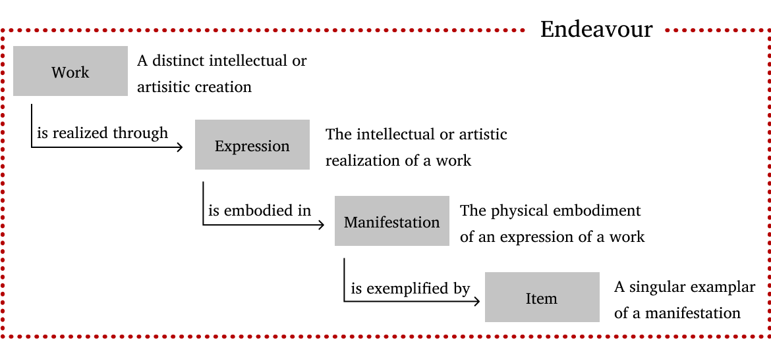
Dublin Core Record Creation
Dublin Core has some principles to consider
Dublin Core Elements are repeatable within a record
A Dublin Core record is supposed to describe one and only one resource --- 1:1 principle.
WEMI can help us identify 1:1-ness
Where does this leave DCMIType values?
I take the confluence of these principles to mean that while a record may have more than one DC:type element, a well formed record can have only one DCMIType value.
Notes:
In a sense then if two values of dc:type exist within a record, it is reasonable to make one of two assumptions: 1) that the unqualified element actually refines the DCMIType qualified element, or that 2) the qualified and unqualified elements exist in two separate descriptive planes.

Slide 4
DCMIType Values & Usage
DCMIType has 12 Values
DCMIType Usage on the Type Element
Collection
Dataset
Event
Image
InteractiveResource
MovingImage
PhysicalObject
Service
Software
Sound
StillImage
Text
Recommended practice is to use a controlled vocabulary such as the DCMI Type Vocabulary [DCMI-TYPE]. To describe the file format, physical medium, or dimensions of the resource, use the Format element.
Notes:
MovingImage and StillImage items must also fit within the qualifications of Image… this in a sense makes them sub-categories.

Slide 5
PhysicalObject - Historical Definitions
Since version 002 --- including the current version 003
Label Physical Object
Definition An inanimate, three-dimensional object or substance.
Comment Note that digital representations of, or surrogates for, these objects should use Image, Text or one of the other types.
Version 001
Label Physical Object
Definition An inanimate, three-dimensional object or substance.
Comment An inanimate, three-dimensional object or substance. For example -- a computer, the great pyramid, a sculpture. Note that digital representations of, or surrogates for, these things should use Image, Text or one of the other types.
Proposal version 1999
A non-human object or substance. This category includes objects that do not fit into any of the other categories on this list. In addition these objects must be approached physically to make use of them. For example - a computer, the great pyramid, a sculpture, wheat. Note that digital representations of, or surrogates for, these things should use image, text or one of the other types.
Notes:
http://dublincore.org/usage/terms/history/#PhysicalObject-003 https://www.dublincore.org/specifications/dublin-core/dcmi-type-vocabulary/
https://www.dublincore.org/specifications/dublin-core/dcmi-type-vocabulary/2006-08-28/

Slide 6
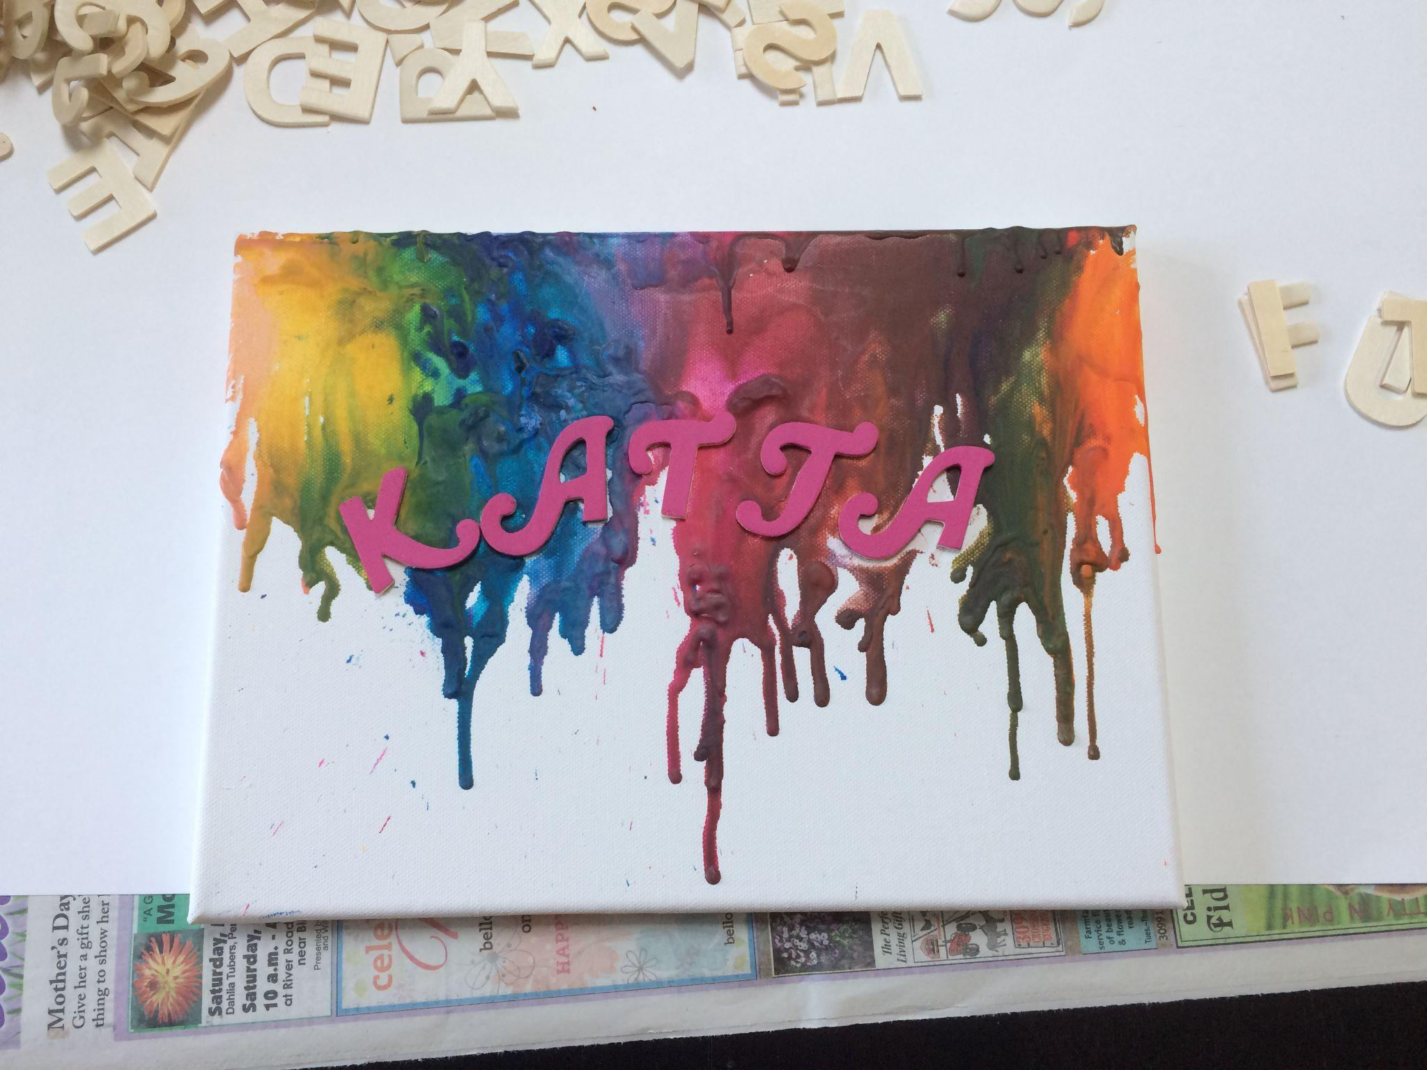
Other Studies
Most Studies
Zavalin & Zavalina (2023)
Most studies do not report any use of DCMIType PhysicalObject --- and with reason digital repositories don’t usually have physical objects… or do they?
Zavalin, V. & Zavalina, O. (2023). Exploration of Accuracy, Completeness and Consistency in Metadata for Physical Objects in Museum Collections. In Sserwanga, I., Goulding, A., Moulaison-Sandy, H., Du, J., Soares, A., Hessami, V. & Frank, R. (Eds.), Information for a Better World: Normality, Virtuality, Physicality, Inclusivity. (pp. 83–90). Springer Nature Switzerland. https://doi.org/10.1007/978-3-031-28032-0_7
Notes:
Zavalin & Zavalina (2023) look at how students in library programs apply DCMIType to physical paintings. The assumption, following a logical understanding of the explanations of DCMIType usage is that paintings should be classified as “DCMIType: image” congruent with Zavalin & Zavalina assertions. However, discussion with DCMI board consultants suggest that true usage is governed by application profiles.

Slide 7
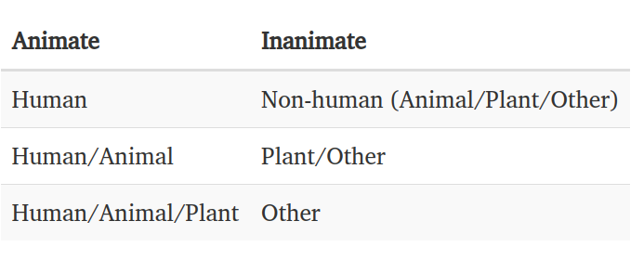
“Inanimate” means what exactly?
The DCMIType definition is not super clear on where the line is drawn cross-linguistically. Logically, for biologists the inanimate often excludes the living—such as plants and animals. This is one of the driving motivations in the of development Darwin Core (Endresen et al., 2012; Baskauf et al., 2016a, b) and its class Organism.

Slide 8
Open Language Archive Community Usage
16 Records --- 61 total data providers; 480,812 total OLAC records
Data Provider | Number of Records | Proper DCMIType | Content
Speech & Language Data Repository (SLDR) | 1 | Dataset | XML
California Language Archive | 3 | Collection | Plant Specimens
The American Philosophical Society | 12 | Collection (uses multiple assignments of DCMIType and Type in source records) | Computer Disks, Plants, Baskets, Crafts, Tools, Blowguns, Reed/Grass ornaments

Slide 9
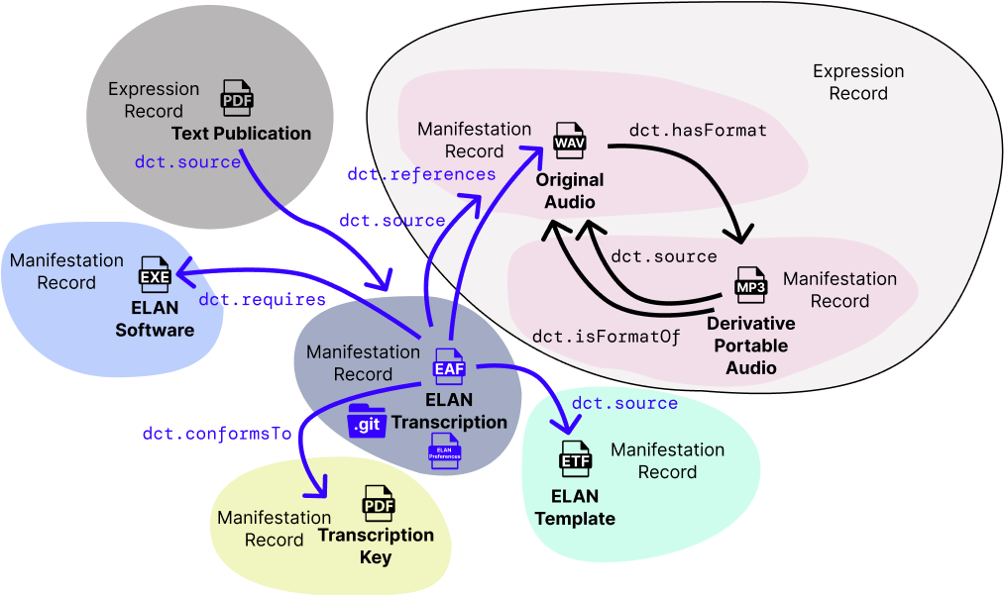
Transcription

Slide 10
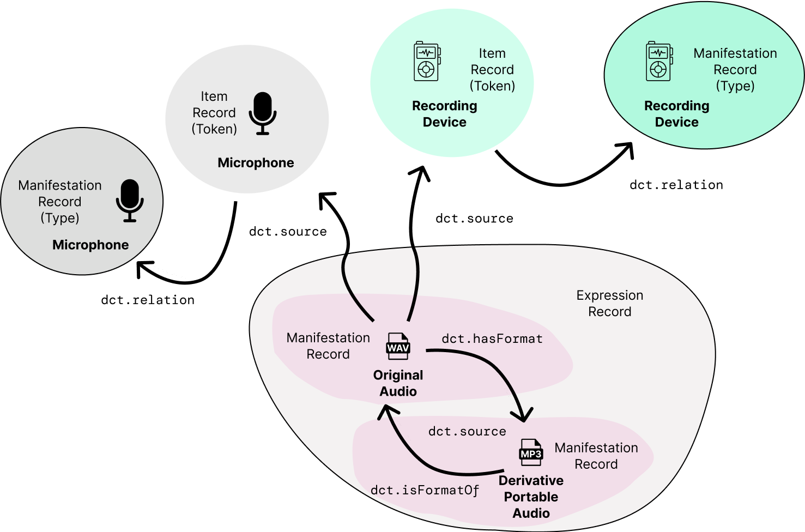
A semantically correct PhysicalObject type use case

